Slide 1
OUT-OF-SCHOOL YOUTH OVERVIEW
MIGRANT EDUCATION PROGRAM

Slide 2
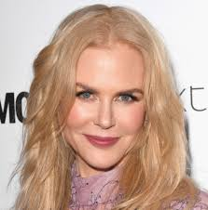
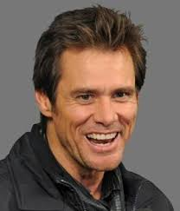
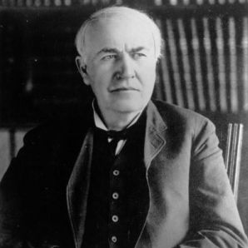
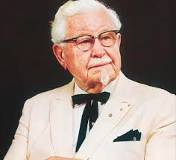
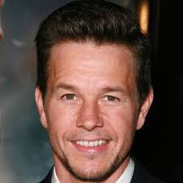
GUESS WHO
Nicole Kidman
Jim Carrey
Thomas Edison
Colonel Sanders
Mark Wahlberg
Whoopi Goldberg

Slide 3
GUESS WHO
Colonel Sanders- Overcame lack of education with the largest drumstick in the fried chicken business.
Nicole Kidman- Left school to help support the family. Later, she finished school & went on to be a successful actress
Jim Carrey- Straight-A student, worked as a security guard and custodian to help the family & then became a comedian.
Whoopi Goldberg- As an adult, discovered her struggles with school were due to an undiagnosed case of dyslexia
Mark Wahlberg- Recently earned his HS diploma at 42 and his children got to see him graduate.
Thomas Edison- Pulled out of school at age 11 for being “difficult” and later became a lawyer and American inventor.
©2017 Region One Education Service Center

Slide 4
AGENDA
UTRGV HEP Presentation
OSY Service Delivery Process
District Roles and Responsibilities
Migrant Out-of-School Youth System (MOSYS)
Overview
PFS OSY

Slide 5
OSY DEFINITION
A child who is a migratory agricultural worker or migratory fisher that has made a qualifying move or a child of a migratory agricultural worker or migratory fisher that has made a qualifying move;
High school-aged youth under 22 years of age;
Not currently enrolled in a K-12 institution;
Lacks a US issued high school diploma (HSD) or high school equivalency (HSE) certificate;
May be enrolled in an HSE program;
May only be “Here to Work”

Slide 6
OSY INITIATIVE
The goal of the Migrant Out-of-School Youth Initiative is to ensure that every identified OSY has access to appropriate services based on identified needs; and to encourage and assist all OSY in achieving their goals.

Slide 7
EXAMPLES OF REFERRALS & SERVICES
Instructional Service
A service to assist in the attainment of education in or outside of the district.
Support Service
A tool/resource to assist with instructional goals or improve quality of life.
Credit Recovery
Remediation for State Assessments
Adult Basic Education
GED/HEP
ESL
Laptop
Materials & Resources
Clothing
Utility Bill Assistance
Transportation Voucher
Child Care

Slide 8
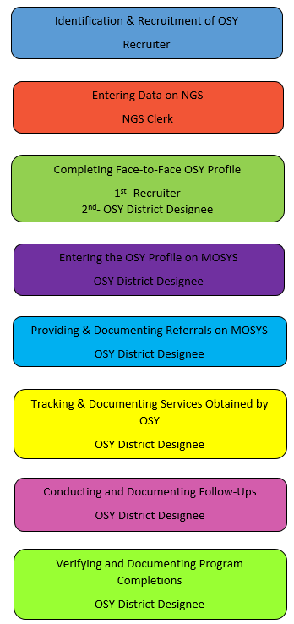
OSY DISTRICT RESPONSIBILITIES

Slide 9
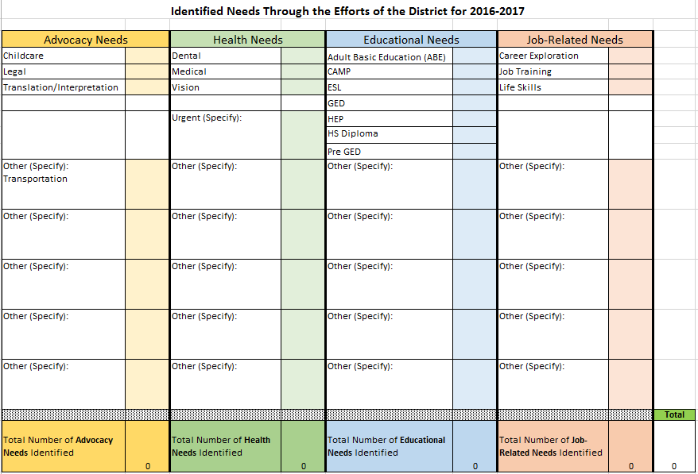
TEA MEP OSY DATA COLLECTION

Slide 10
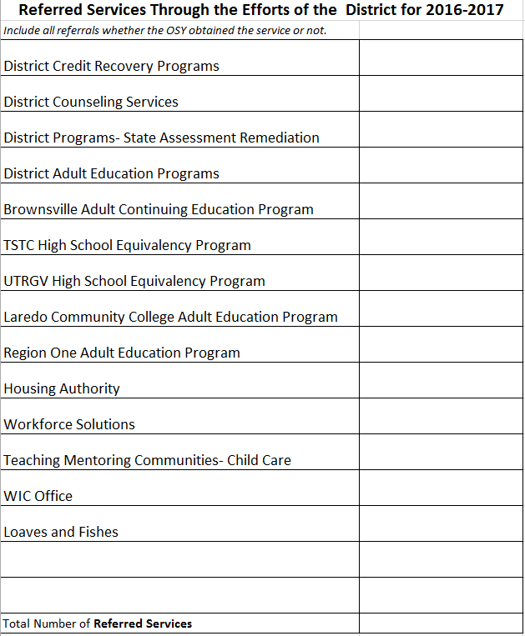
TEA MEP OSY DATA COLLECTION

Slide 11
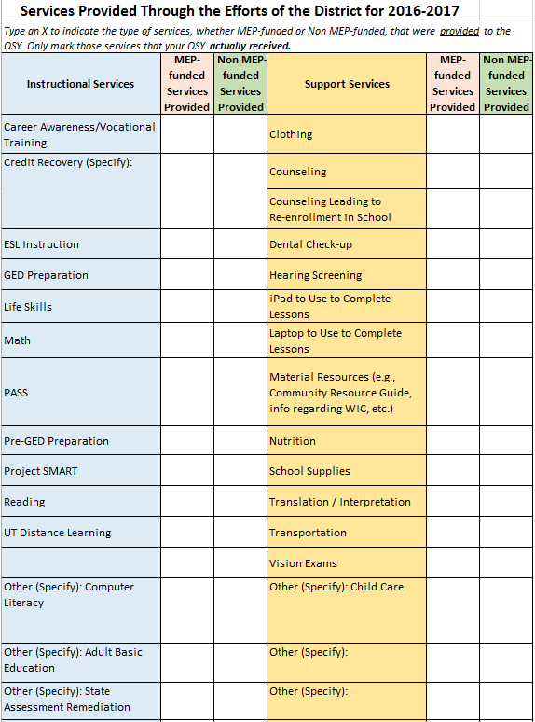
TEA MEP OSY DATA COLLECTION

Slide 12
OSY PROFILE
Tool used to assess the needs and interests of the OSY at least once annually, and every time a student transfers to a new district
Captures the current circumstances that the OSY is in at the time of the initial FACE-TO-FACE interview.
It is critical that the OSY is interviewed and not the parent.
Needs and interests must be recorded under the PROFILE tab in MOSYS by the OSY District Designee.

Slide 13
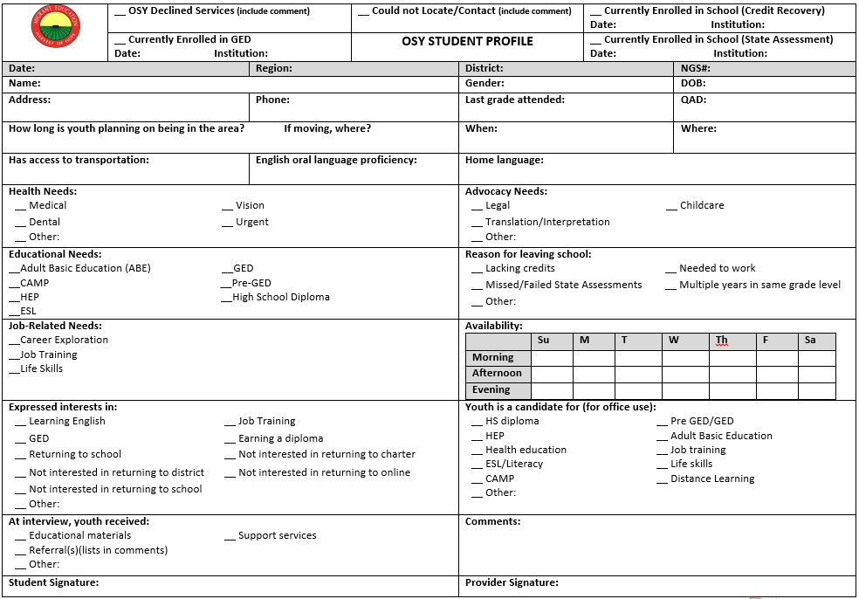

Slide 14
OSY PROFILE SCENARIOS

Slide 15
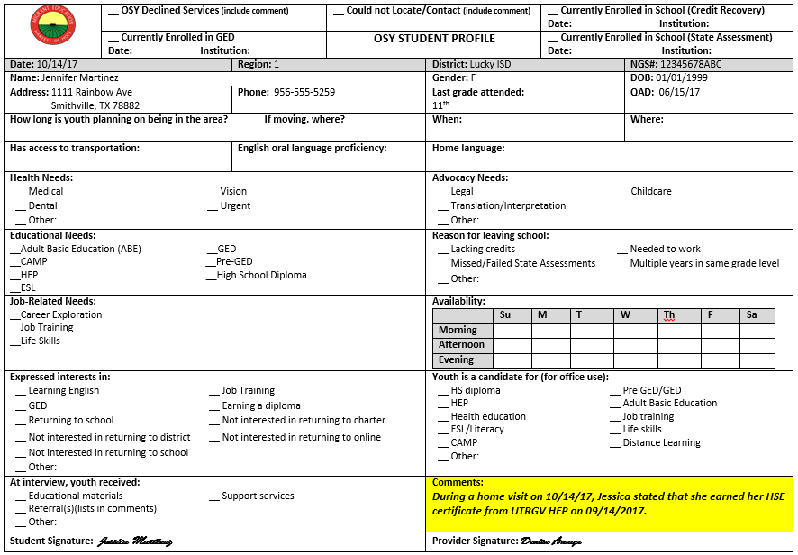
SCENARIO 1:OSY HAS EARNED A HS DIPLOMA OR HSE CERTIFICATE On 10/14/2017, you make a home visit to interview OSY Jennifer Martinez. She states that she has earned her HSE Certificate from UTRGV on 09/14/17.

Slide 16
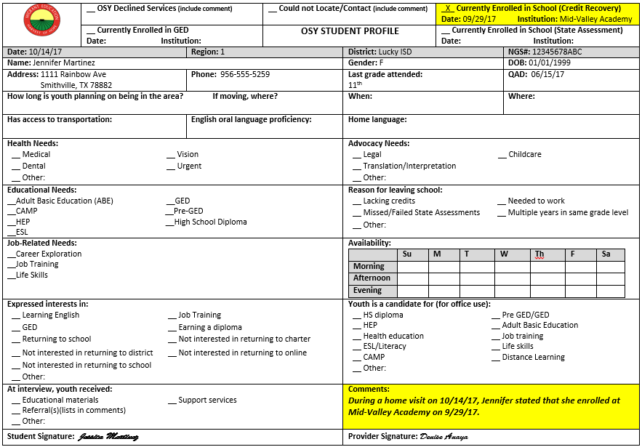
SCENARIO 2: ENROLLED IN A K-12 INSTITUTION On 10/14/2017, you make a home visit to interview OSY Jennifer Martinez. She states that she is currently enrolled at the Mid-Valley Academy.

Slide 17
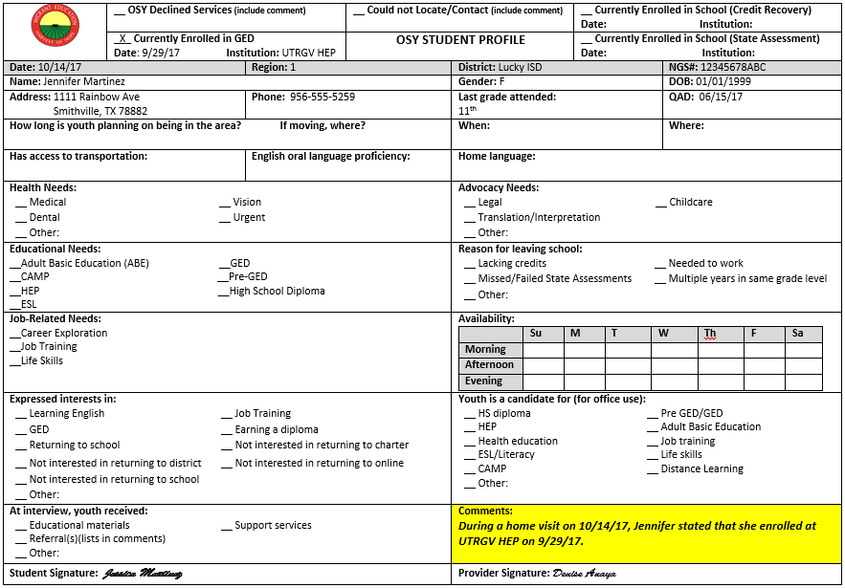
SCENARIO 3: CURRENTLY ENROLLED IN AN HSE PROGRAM On 10/14/2017, you make a home visit to interview OSY Jennifer Martinez. She states that she is currently enrolled at UTRGV HEP.

Slide 18
OSY DISTRICT DESIGNEE TASKS (scenarios 1-3)
Verify and Document HS Diploma
Verify and Document HSE Certificate
Verify and Document Enrollment in K-12 Institution
Place of Enrollment
Date of Enrollment
Current Grade Level
Verify and Document Enrollment in an HSE Program
Place of Enrollment
Date of Enrollment

Slide 19
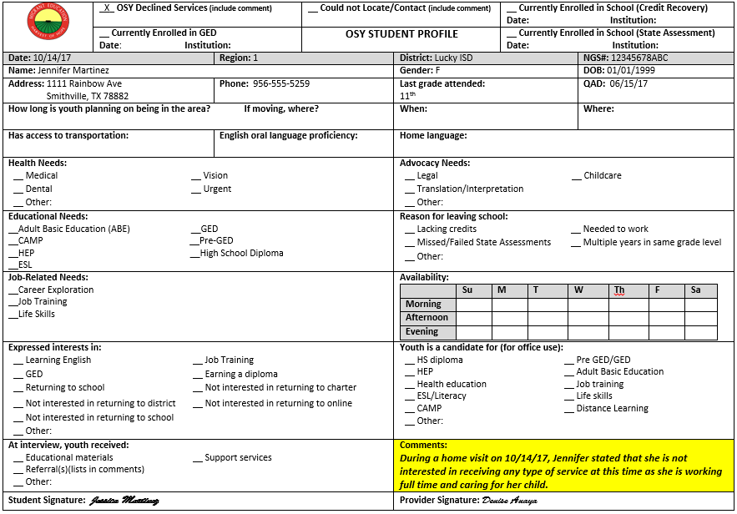
SCENARIO 4: DECLINED SERVICES On 10/14/2017, you make a home visit to interview OSY Jennifer Martinez. She states that she is not interested in receiving any type of service at this time.

Slide 20
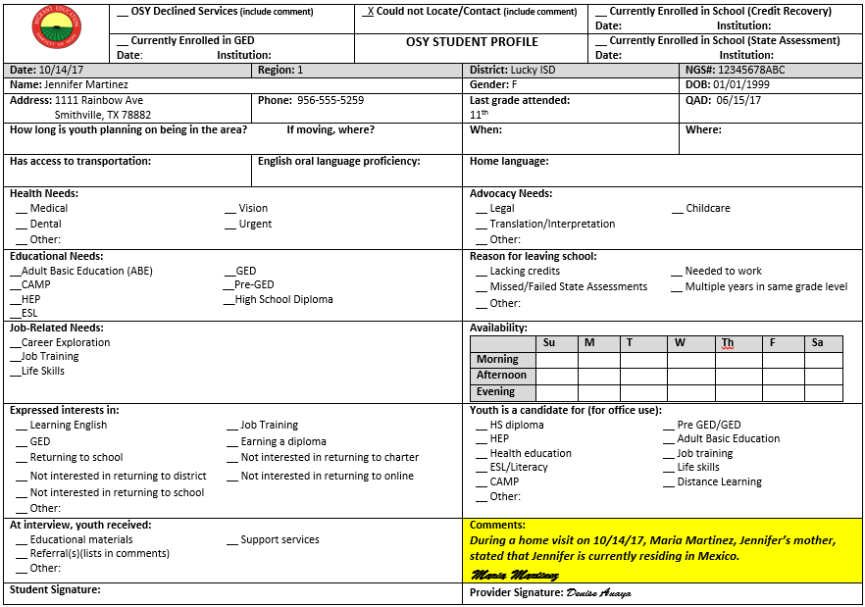
SCENARIO 5: COULD NOT LOCATE On 10/14/2017, you make a home visit to interview OSY Jennifer Martinez. Her mother states that Jennifer is residing in Mexico.

Slide 21
NOT ABLE TO LOCATE
EXAMPLES ✓
NON-EXAMPLES ✗
Not residing in district
Deported
Incarcerated
Address unknown
Living in residential facility
Working
At an appointment
Out of town on temporary basis
Asleep
Running errands

Slide 22
SCENARIO 6: NOT AVAILABLE (but in your district) On 10/14/2017, you make a home visit to interview OSY Jennifer Martinez. Her mother states that Jennifer was called in to work.

Slide 23
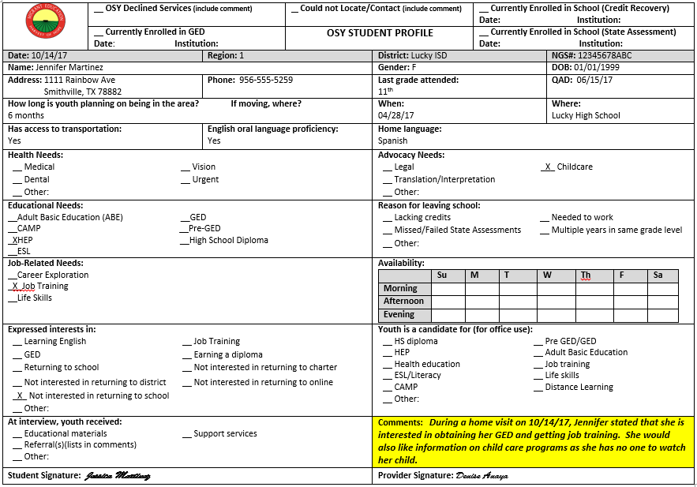
SCENARIO 7: INTERSTED IN RECEIVING SERVICES On 10/14/2017, you make a home visit to interview OSY Jennifer Martinez. She states that she is interested in HEP and job training, however, she is in need of child care services.

Slide 24
STUDENT REFERRALS
Captures educational background of the OSY
Records referrals and information/materials given to the OSY. Names of agencies and programs must be recorded
Is based on the needs and expressed interests that were captured in the profile

Slide 25
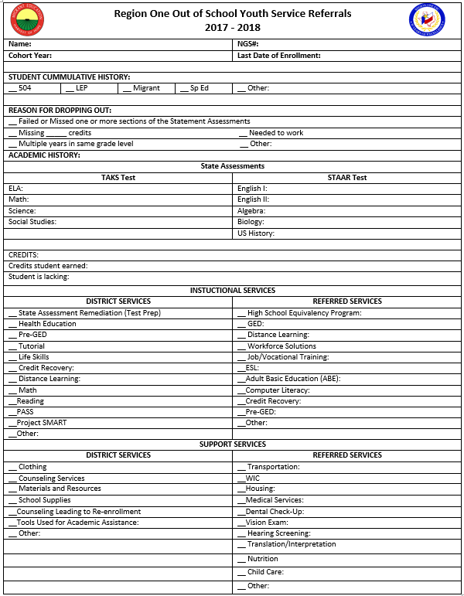

Slide 26
SERVICES RECEIVED
Records services that the OSY has actually received, including: 1. Enrollments in HSE
2. Enrollment in HS
Only services that the child receives as a result of efforts and referrals made by the OSY district personnel are to be checked off in this section.
If an OSY obtains a service on his or her own, it is not to be documented on this section as the district personnel did not make this referral.
If services received by the OSY were funded by the MEP, check off the MEP Funded box next to the service

Slide 27
MEP FUNDED SERVICES
EXAMPLES ✓
NON-EXAMPLES ✗
School Supplies
Clothing
Counseling
Tutorial
Tools for Academic Assistance
WIC Referrals
Housing
HEP
Transportation
Child Care

Slide 28
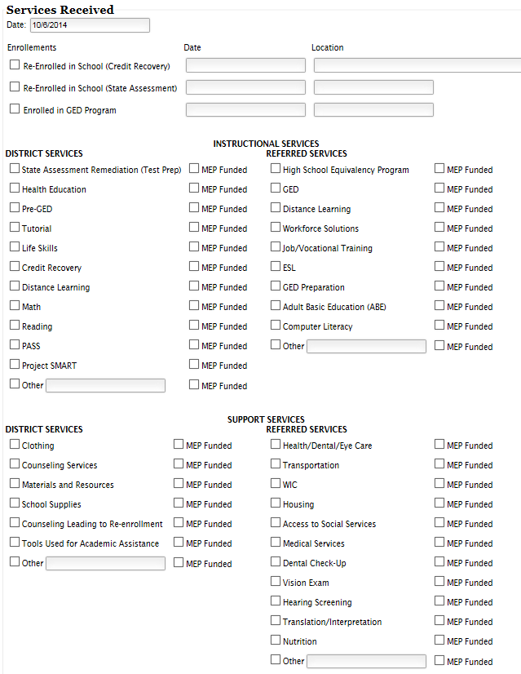

Slide 29
EXIT
Documents Program Completion:
1. Earned High School Diploma or GED*
-Obtain and enter Date and Location of Certificate
2. Turned 22 years old
-Exit OSY at the end of the semester that they turned 22
3. Deceased
-Under Notes, enter your source and the date you
obtained information
*Texas Certificate/Transcript Search:
https://bass.tea.state.tx.us/Tea.GEDi.Web/Forms/CertificateSearch.aspx

Slide 30
CONTACT LOG
A Contact Log will automatically generate when profile is first submitted
Documents follow-ups
On-going assessment for new needs that may arise
Regarding: Purpose Example: Contacted OSY to see if she has enrolled in the HEP.
Follow-Up: Outcome Example: OSY states she has a meeting with UTPA HEP counselor on Sept 1st and plans to enroll in the program at that time.

Slide 31
MIGRANT-OUT-OF-SCHOOL YOUTH SYSTEM
MOSYS
www.esc1.net/mosys

Slide 32
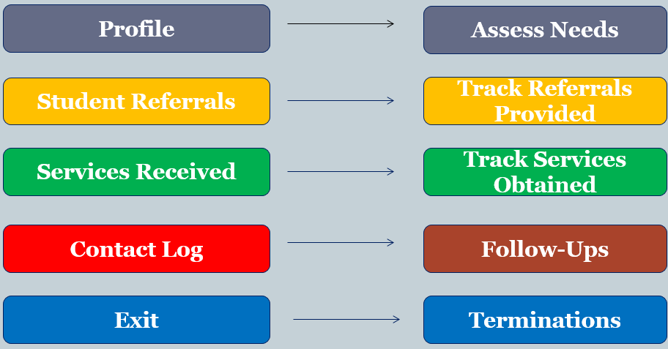

Slide 33
MOSYS
NGS and MOSYS do not communicate. NGS OSY Report must be run monthly.
List from the NGS OSY Report must be entered on MOSYS, insuring that NGS OSY Report and MOSYS Student List match.
An OSY will continue to appear on both the NGS OSY Report and the MOSYS Student List even though: -OSY QAD has expired
-OSY has enrolled in HS
-OSY has exited the program

Slide 34
OSY TIMELINE FOR CONDUCTING FOLLOW-UPS
OSY Scenario | Timeline
Receives a Referral | Once/Month
Receives Direct Services | Once/Month
Is Unavailable (not a leaver) * | Once/Month
Declines Services* | Once/Semester
Could not locate (leaver)* | Once/Semester
*Comment required on Student Profile

Slide 35
OSY AS PFS

Slide 36
PRIORITY FOR SERVICE (PFS) STUDENT PROGRESS REVIEWS FOR OS
Felix Anzaldua is an Out-of-School Youth residing in Brownsville ISD. He dropped out of school on 05/01/2017 and has not returned since.
Scenario #1: Declines Services
Scenario #2: Unable to Locate
Scenario #3: Services Addressing Priority Reason
Scenario #4: Services Not Related to Priority Reason

Slide 37
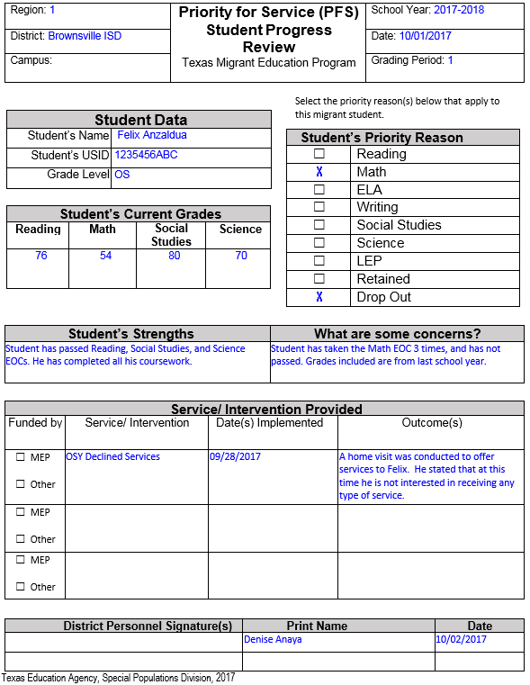
SAMPLE PFS STUDENT PROGRESS REVIEW OS – DECLINED SERVICES

Slide 38
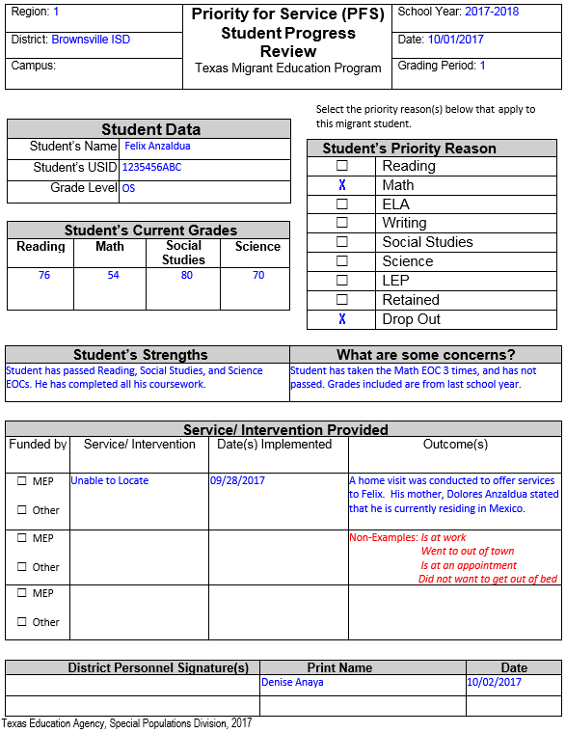
SAMPLE PFS STUDENT PROGRESS REVIEW OS – UNABLE TO LOCATE

Slide 39
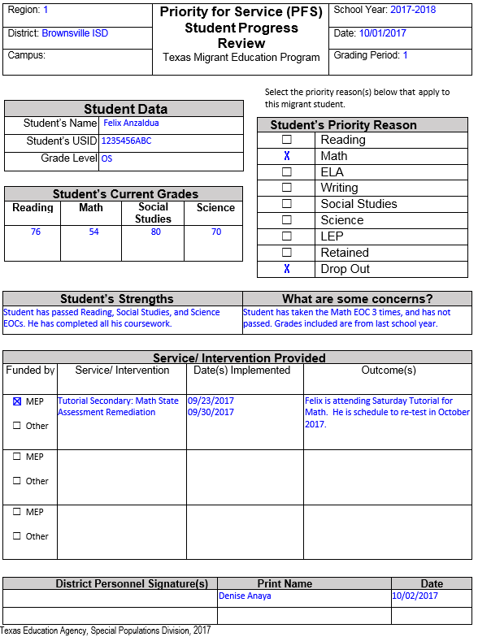
SAMPLE PFS STUDENT PROGRESS REVIEW OS- SERVICES

Slide 40
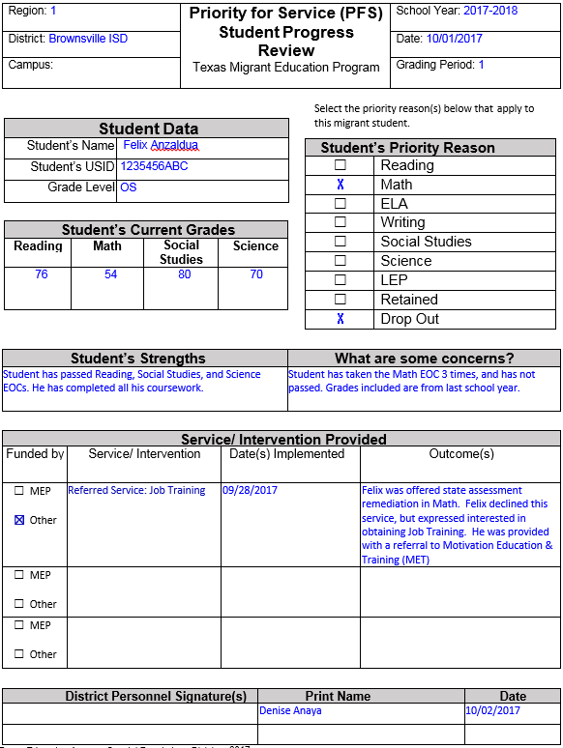
SAMPLE PFS STUDENT PROGRESS REVIEW OS- SERVICES NOT RELATED TO PRIORITY REASON(S)

Slide 41
REGION ONE CONTACT
DENISE ANAYA, M.A.
OUT-OF-SCHOOL YOUTH SPECIALIST
REGION ONE EDUCATION SERVICE CENTER
MIGRANT EDUCATION PROGRAM
956-984-6187
DANAYA@ESC1.NET

